Slide 1

Develop Real time full stack web application using S3, lambda, apigateway, dynamodb
Presented By,
Dr.S.Srithar
Associate Professor,
Department of EL&GE,
KL University, Andhra Pradesh

Slide 2
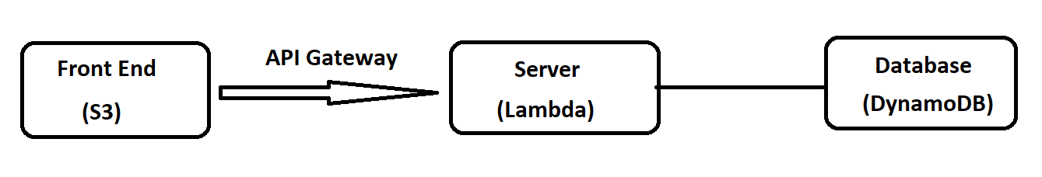
Experiment Work Flow
Steps:
Create IAM role to connect Lambda & DynamoDB
Configure lambda
Configure API gateway
Configure DynamoDB
Configure S3
Supporting files available in :
https://github.com/srithars/aws/blob/main/API%20Lambda%20S3%20DynamoDB%20connect
2

Slide 3
Step 1:
1. IAM Role (for DynamoDB & Lambda) connection:
IAM→Role→Create Role
  Trusted Entity: AWS Service
  Usecase: Lambda
Attach “AmazonDynamoDBFullAccess” policy→Next
Provide Rolename (Eg:DynamoDBfull) & create

Slide 4
Step 2:
2. Lambda:
Create a lambda function with following configuration:
Function Name: Fun1
Runtime: Python 3.8
Change default execution role:use an existing rols
RoleName: DynamoDBfull (As per Step 2)
Finally click Create a function

Slide 5
Step 2 cont…
Add the sample code in lamda_function.py file.
import json
import math
def lambda_handler(event, context):
mathResult = math.pow(int(event['base']), int(event['exponent']))
# return a properly formatted JSON object
return {
'statusCode': 200,
'body': json.dumps('Your result is ' + str(mathResult))
}
→Deploy
Code also available in : https://github.com/srithars/aws/blob/main/API%20Lambda%20S3%20DynamoDB%20connect
Testing:
Test→configure test event
Test name: test1
Event JSON
{
"base": 4,
"exponent": 5
}

Slide 6
Step 3:
3. API Gateway:
Open REST API→Build→API Name: test
Click Create API
Click Create Method→Select “Post”→
  Lambda function: test
  ARN: Copy ARN from the “test” lambda (Eg:arn:aws:lambda:us-east-1:975050203348:function:fun1)
  ->Click create Method
Move to Test
Request Body as,
{
"base": 4,
"exponent": 5
}

Slide 7
Step 4:
4. DynamoDB:
Create a DynamoDB table with the following configuration:
    Table Name: math
    Partition key: id
    Data Type: String

Slide 8
Step 2 (update code now):
Update the code in lamda_function.py file.
import json
import math
import boto3
dynamodb = boto3.resource('dynamodb')
table = dynamodb.Table('math')
def lambda_handler(event, context):
mathResult = math.pow(int(event['base']), int(event['exponent']))
response = table.put_item(
Item={
'id': str(mathResult)
})
# return a properly formatted JSON object
return {
'statusCode': 200,
'body': json.dumps('Your result is ' + str(mathResult))
}
Code also available in :
https://github.com/srithars/aws/blob/main/API%20Lambda%20S3%20DynamoDB%20connect

Slide 9
Step 5:
5. S3 front end configuration
Move to S3 service
Click on Create a bucket
Bucket name: klu990 (it should be unique)
Object Ownership: ACL Enabled
Block Public Access settings for this bucket: uncheck (Block all public access)
Bucket versioning: Enable
->create bucket
3. Upload index.html file→Action→make public using ACL
4. Properties→Static website hosting: Edit→enable→Index document: index.html→save
Note:
Index.html file available in
https://github.com/srithars/aws/blob/main/API%20Lambda%20S3%20DynamoDB%20connect

Slide 10
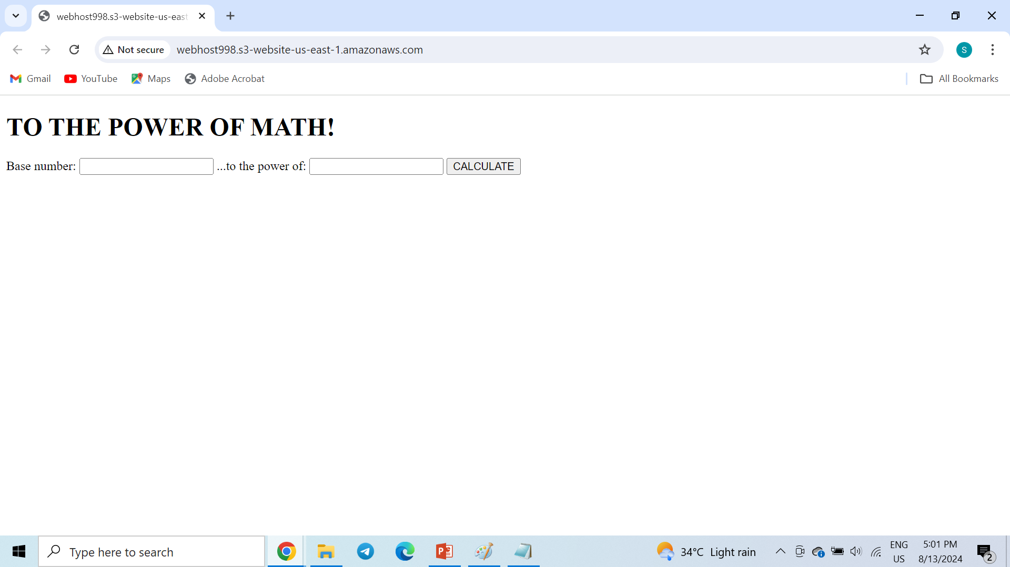
Testing:
Take a URL of static website hosting and paste it in browser.

Slide 11
Thank You!!!

